Slide 1
YOLO
Tran Le Anh
anhtl@ut.edu.vn

Slide 2
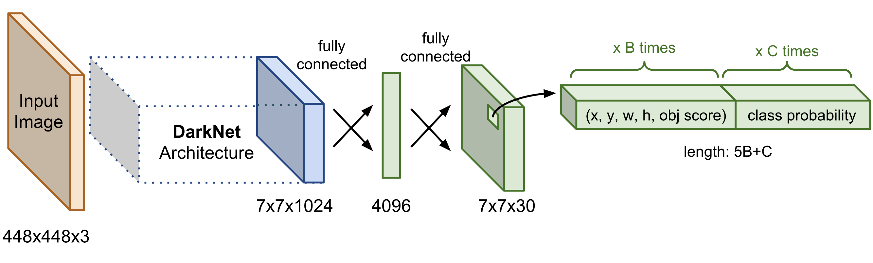
YOLOv1
YOLOv1 Architecture

Slide 3
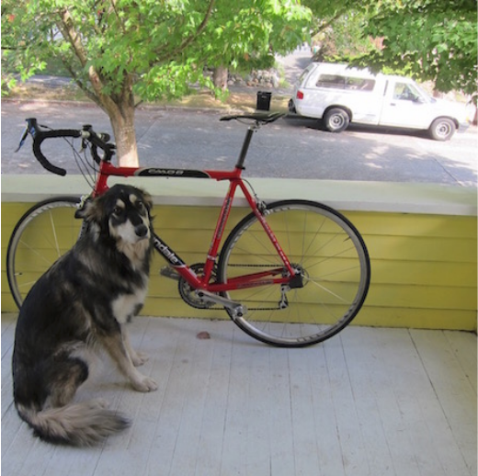
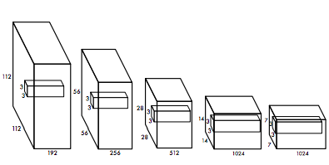
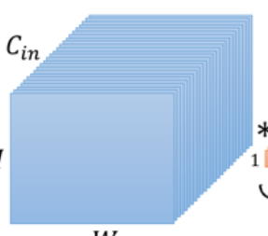
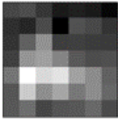
YOLOv1
YOLOv1 Architecture
7x7x1024
input

Slide 4
YOLOv1
YOLOv1 Architecture
7x7x1024
input

Slide 5
YOLOv1
YOLOv1 Architecture
7x7x1024
input

Slide 6
YOLOv1
YOLOv1 Architecture
7x7x1024
input

Slide 7
YOLOv1
YOLOv1 Architecture
7x7x1024
input

Slide 8
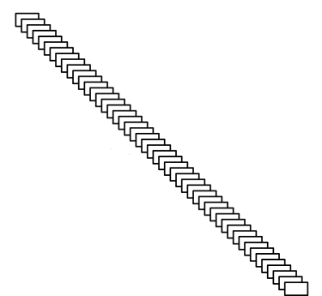
YOLOv1
YOLOv1 Architecture
7x7x1024
input
55x55x3
1x1x1024

Slide 9
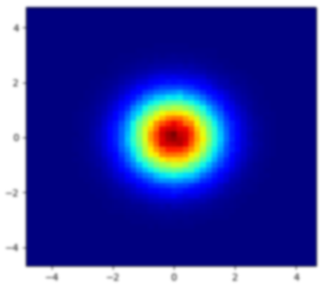
YOLOv1
YOLOv1 Architecture
7x7x1024
input
55x55x3
1x1x1024

Slide 10

YOLOv1
YOLOv1 Architecture
7x7x1024
7x7x30

Slide 11
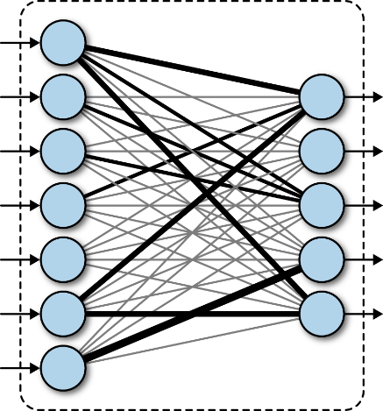
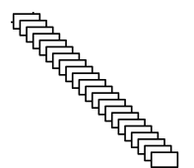
YOLOv1
YOLOv1 Architecture
7x7x1024
7x7x30
flatten
4096
reshape
50176
1470

Slide 12
YOLOv1
YOLOv1 Architecture
7x7x1024
7x7x30
4096
50176
1470

Slide 13
YOLOv1
YOLOv1 Architecture
x1
y1
w1
h1
p1
…
p2
c0
…
cn
…
c19
Box1
Box2
7x7x1024
7x7x30
4096
20 classes
50176
1470

Slide 14

YOLOv1
YOLOv1 Architecture
x1
y1
w1
h1
p1
…
p2
c0
…
cn
…
c19
Box1
Box2
7x7x1024
7x7x30
4096
20 classes
50176
1470

Slide 15
YOLOv1
YOLOv1 Architecture
x1
y1
w1
h1
p1
…
p2
c0
…
cn
…
c19
Box1
Box2
7x7x1024
7x7x30
4096
20 classes
50176
1470

Slide 16
YOLOv1
YOLOv1 Architecture
x1
y1
w1
h1
p1
…
p2
c0
…
cn
…
c19
Box1
Box2
7x7x1024
7x7x30
4096
20 classes
50176
1470

Slide 17
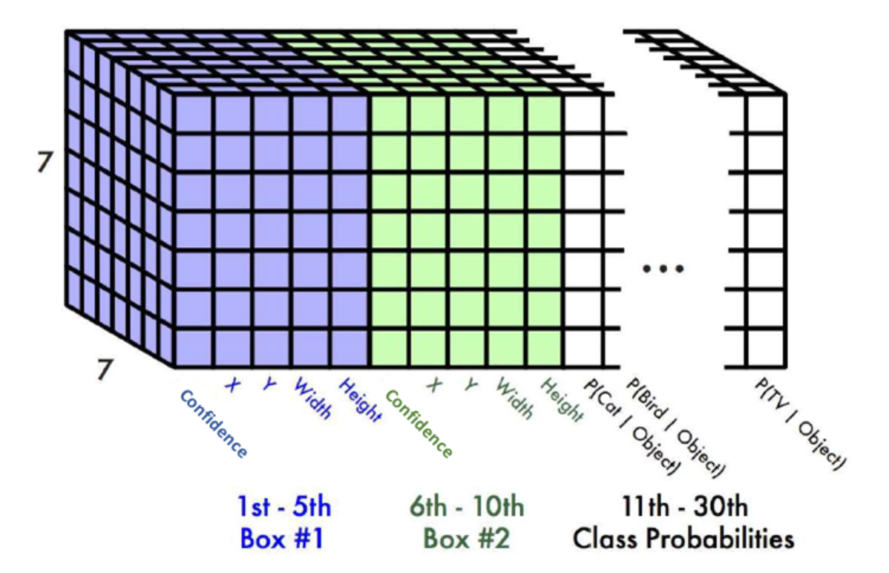
YOLOv1
YOLOv1 Architecture
x1
y1
w1
h1
p1
…
p2
c0
…
cn
…
c19
Box1
YOLOv1 Output
Box2
7x7x30
20 classes

Slide 18
YOLOv1
YOLOv1 TRAINING
7x7x1024
7x7x30

Slide 19

YOLOv1
YOLOv1 TRAINING
10
172
140
420
1
…
1
0
…
1
…
0
[10, 172, 140, 420]
Box1
Box2
7x7x1024
Back-Prob
7x7x30
20 classes
e.g. c[10] = 1
10th: dog
50176
1470

Slide 20
YOLOv1
YOLOv1 TRAINING
…
…
…
…
0
…
0
0
…
0
…
0
Box1
Box2
7x7x1024
Back-Prob
7x7x30
20 classes
e.g. c[10] = 1
10th: dog
50176
1470

Slide 21
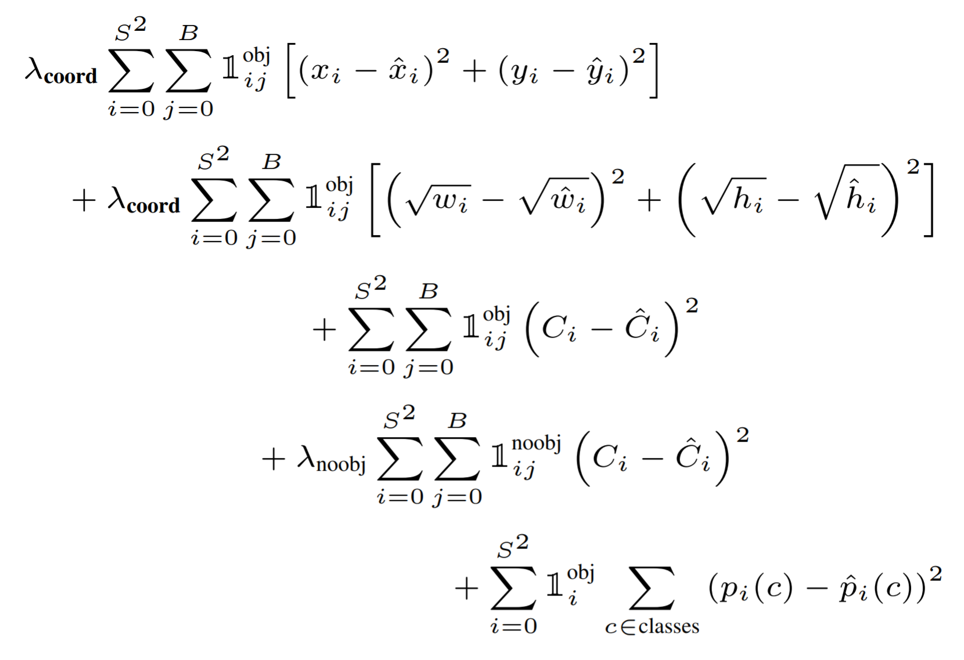
YOLOv1
YOLOv1 TRAINING
…
…
…
…
0
…
0
0
…
0
…
0
Box1
LOSS FUNCTION:
Box2
20 classes
e.g. c[10] = 1
10th: dog

Slide 22
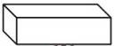
YOLOv2
YOLOv2 Architecture [Link]
[1x1x1024] x length
B(5+C)
13x13x1024
13x13
xlength
YOLOv1: 5B+C
416x416x3

Slide 23
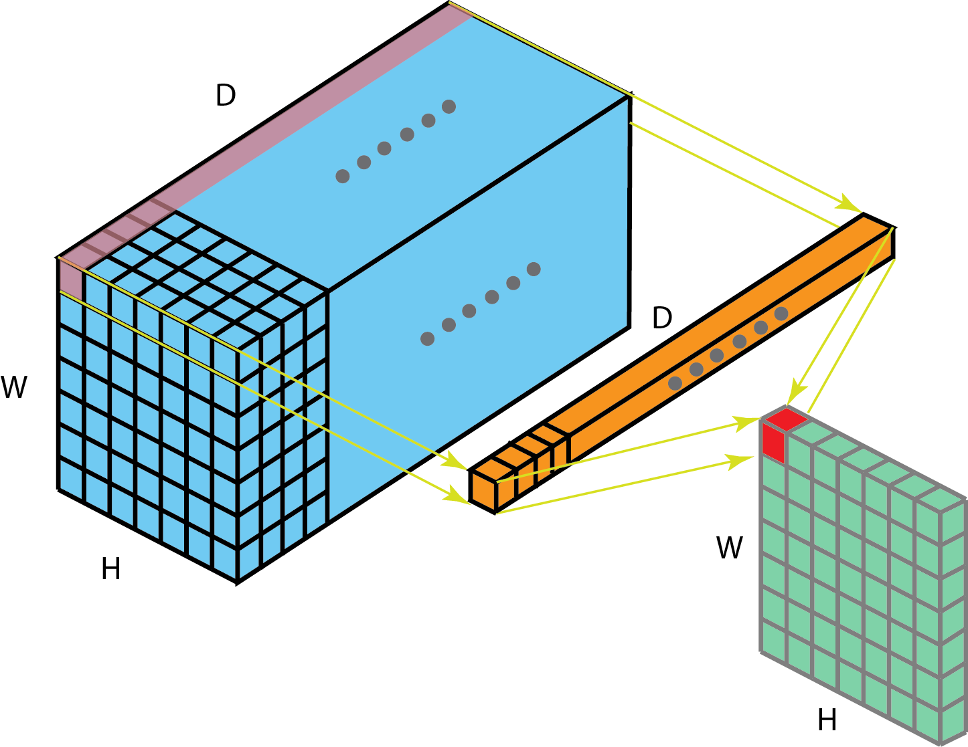
YOLOv2
YOLOv2 Architecture [Link]
[1x1x1024] x length
B(5+C)
13x13x1024
13x13
xlength
YOLOv1: 5B+C
416x416x3
x B(5+C)
B(5+C)

Slide 24
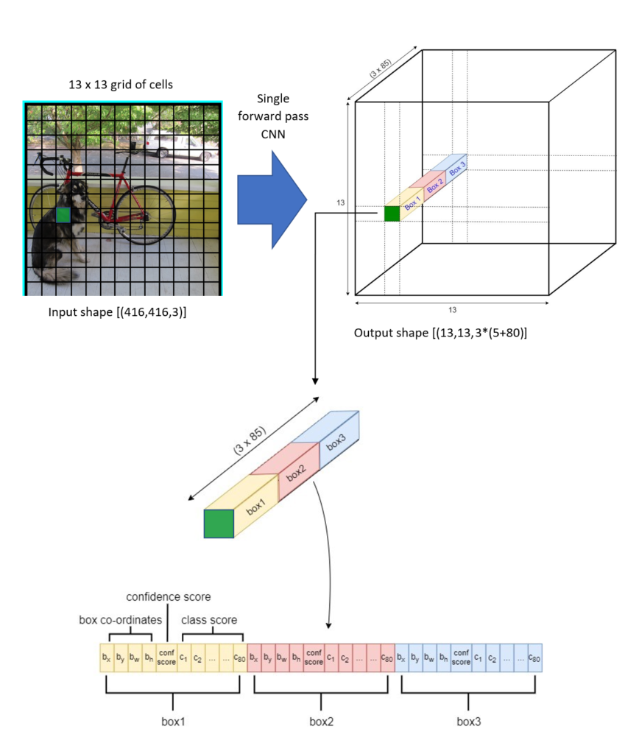
YOLOv2
YOLOv2 Architecture [Link]
[1x1x1024] x length
B(5+C)
13x13x1024
13x13
xlength
YOLOv1: 5B+C
416x416x3
x B(5+C)
B(5+C)

Slide 25
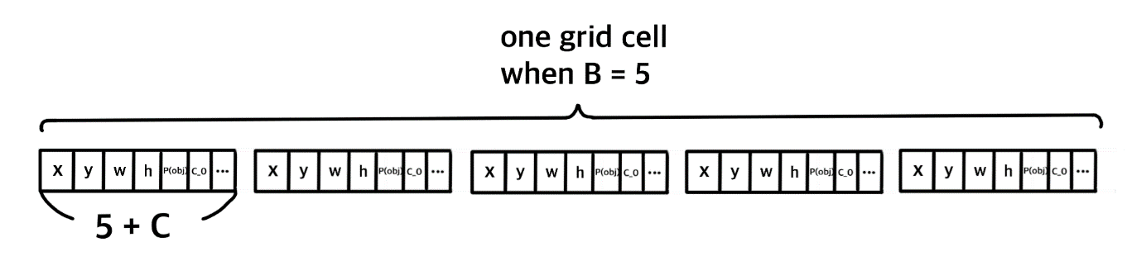
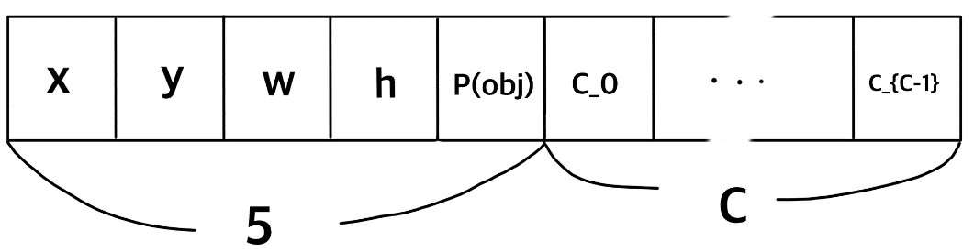
YOLOv2
YOLOv2 Architecture [Link]
[1x1x1024] x length
B(5+C)
13x13x1024
13x13
xlength
YOLOv1: 5B+C
416x416x3
1 box

Slide 26
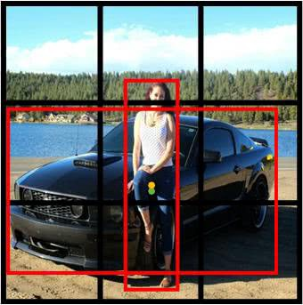
YOLOv2
YOLOv2 Architecture [Link]
[1x1x1024] x length
B(5+C)
13x13x1024
13x13
xlength
YOLOv1: 5B+C
416x416x3
YOLOv1: car or person
YOLOv2: car and person
1x1xdepth
1x1xlength

Slide 27
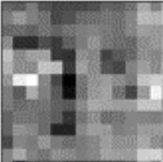
YOLOv2
YOLOv2 Architecture [Link]
[1x1x1024] x length
B(5+C)
13x13x1024
13x13
xlength
416x416x3
13x13x1024
13x13xlength
???
1x1x1024
1x1xlength

Slide 28
YOLOv2
YOLOv2 Architecture [Link]
[1x1x1024] x length
B(5+C)
13x13x1024
13x13
xlength
416x416x3
1x1xlength
box1
tx | ty | tw | th | to | c0 | c1 | … | cn

Slide 29
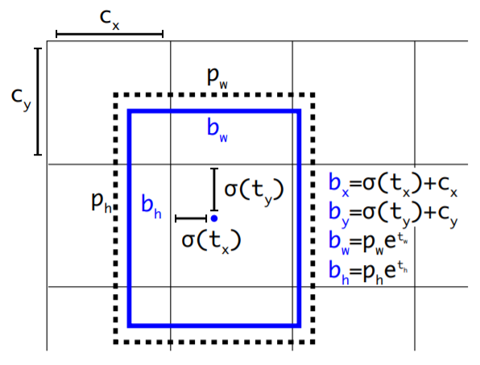
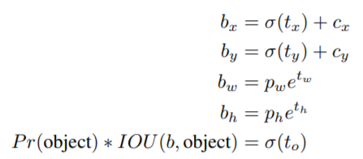
YOLOv2
YOLOv2 Architecture [Link]
[1x1x1024] x length
B(5+C)
13x13x1024
13x13
xlength
416x416x3
1x1xlength
box1
tx | ty | tw | th | to | c0 | c1 | … | cn
1x1xlength
x | y | w | h | p | c0 | c1 | … | cn

Slide 30
YOLOv2
YOLOv2 Architecture [Link]
[1x1x1024] x length
B(5+C)
13x13x1024
13x13
xlength
416x416x3
1x1xlength
box1
tx | ty | tw | th | to | c0 | c1 | … | cn
1x1xlength
x | y | w | h | p | c0 | c1 | … | cn

Slide 31
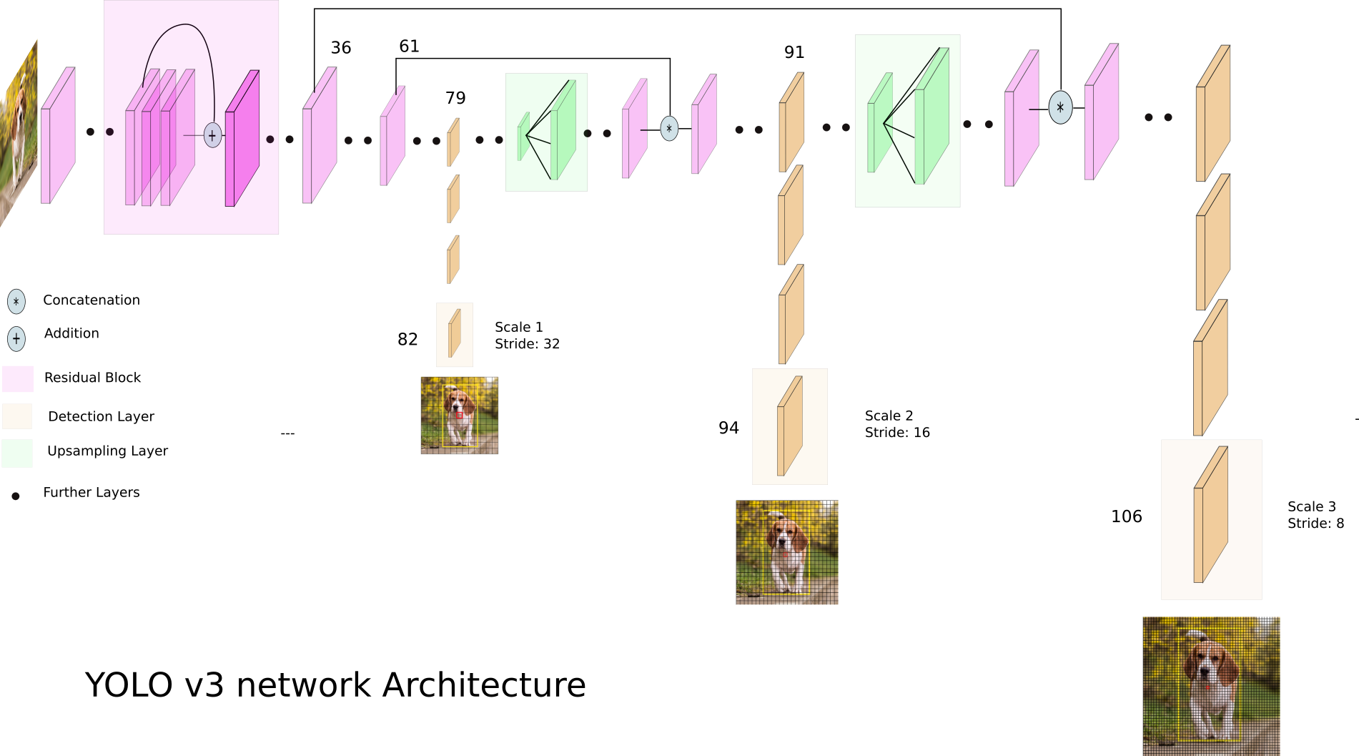
YOLOv3
YOLOv3 Architecture [Link]

Slide 32
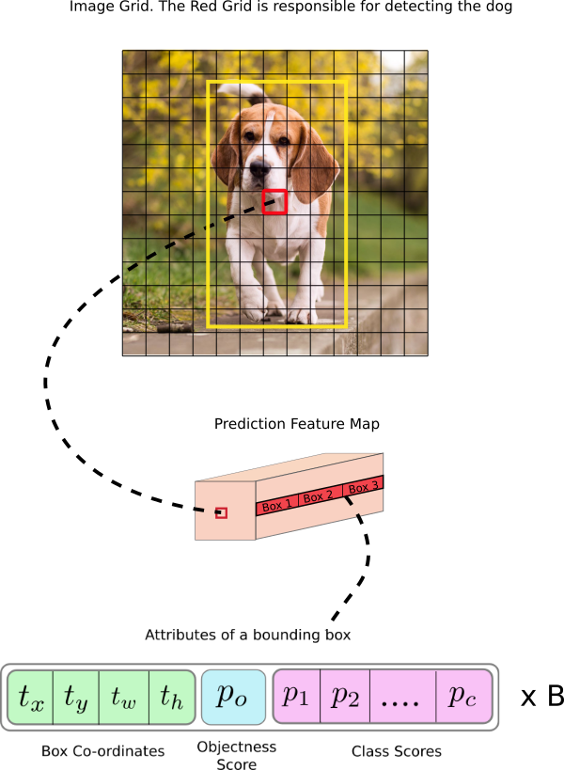
YOLOv3
YOLOv3 Architecture [Link]

Slide 33
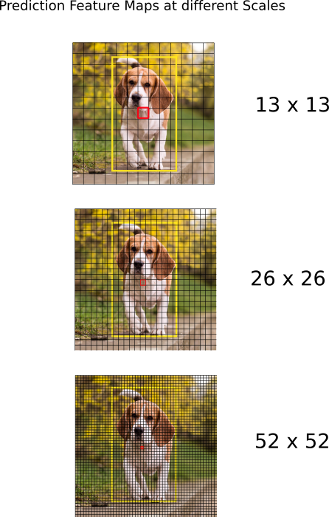
YOLOv3
YOLOv3 Architecture [Link]
3 Scales???
7x7
104x104

Slide 34
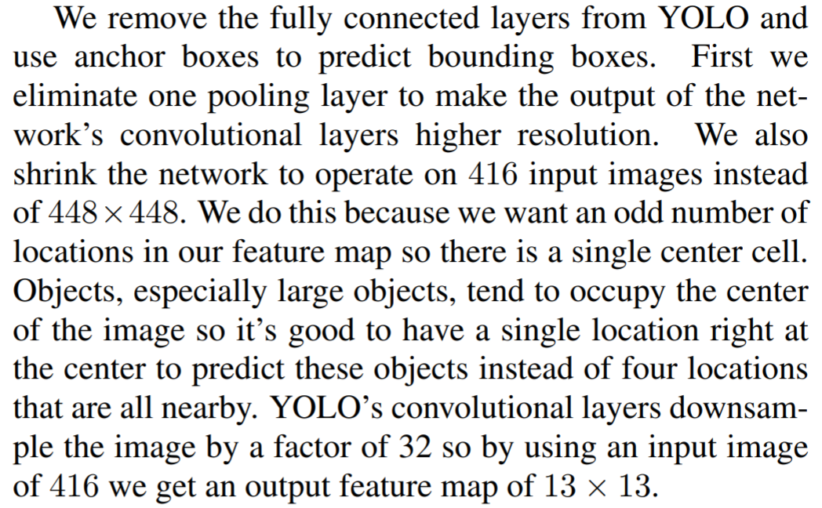
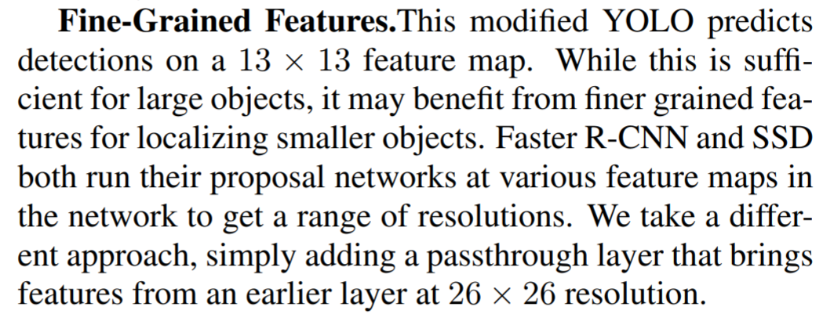
YOLOv3
YOLOv3 Architecture [Link]
3 Scales???
YOLOv2 Paper:
7x7

Slide 35
YOLOv3
YOLOv3 Architecture [Link]
3 Scales???
104x104
Anchor Sizes
Scale 1: [116,90] [156,198] [373,326]
Scale 2: [30,61] [62,45] [59,119]
Scale 3: [10,13] [16,30] [33,23]

Slide 36
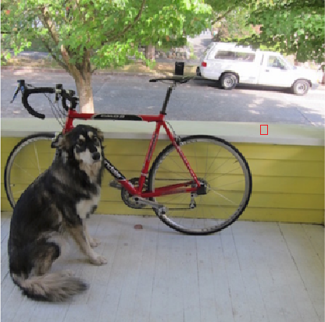
YOLOv3
YOLOv3 Architecture [Link]
3 Scales???
104x104
Anchor Sizes
Scale 1: [116,90] [156,198] [373,326]
Scale 2: [30,61] [62,45] [59,119]
Scale 3: [10,13] [16,30] [33,23]
416x416

Slide 37
Thank You

